Slide 1
Biochemistry is now ubiquitous: time to transition from reductionism to holism?
🐯
🐞
👽
Greg Gloor
Department of Biochemistry
The University of Western Ontario
https://github.com/ggloor/compositions/presentations

Slide 2
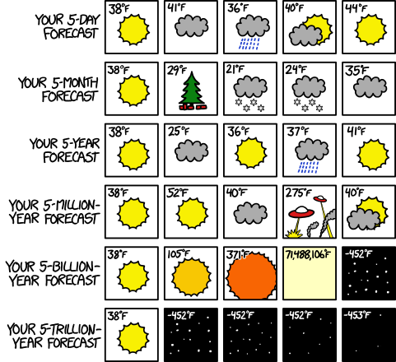
Outline
A bit about me
A bit about the landscape
Vision for the future
XKCD.com

Slide 3
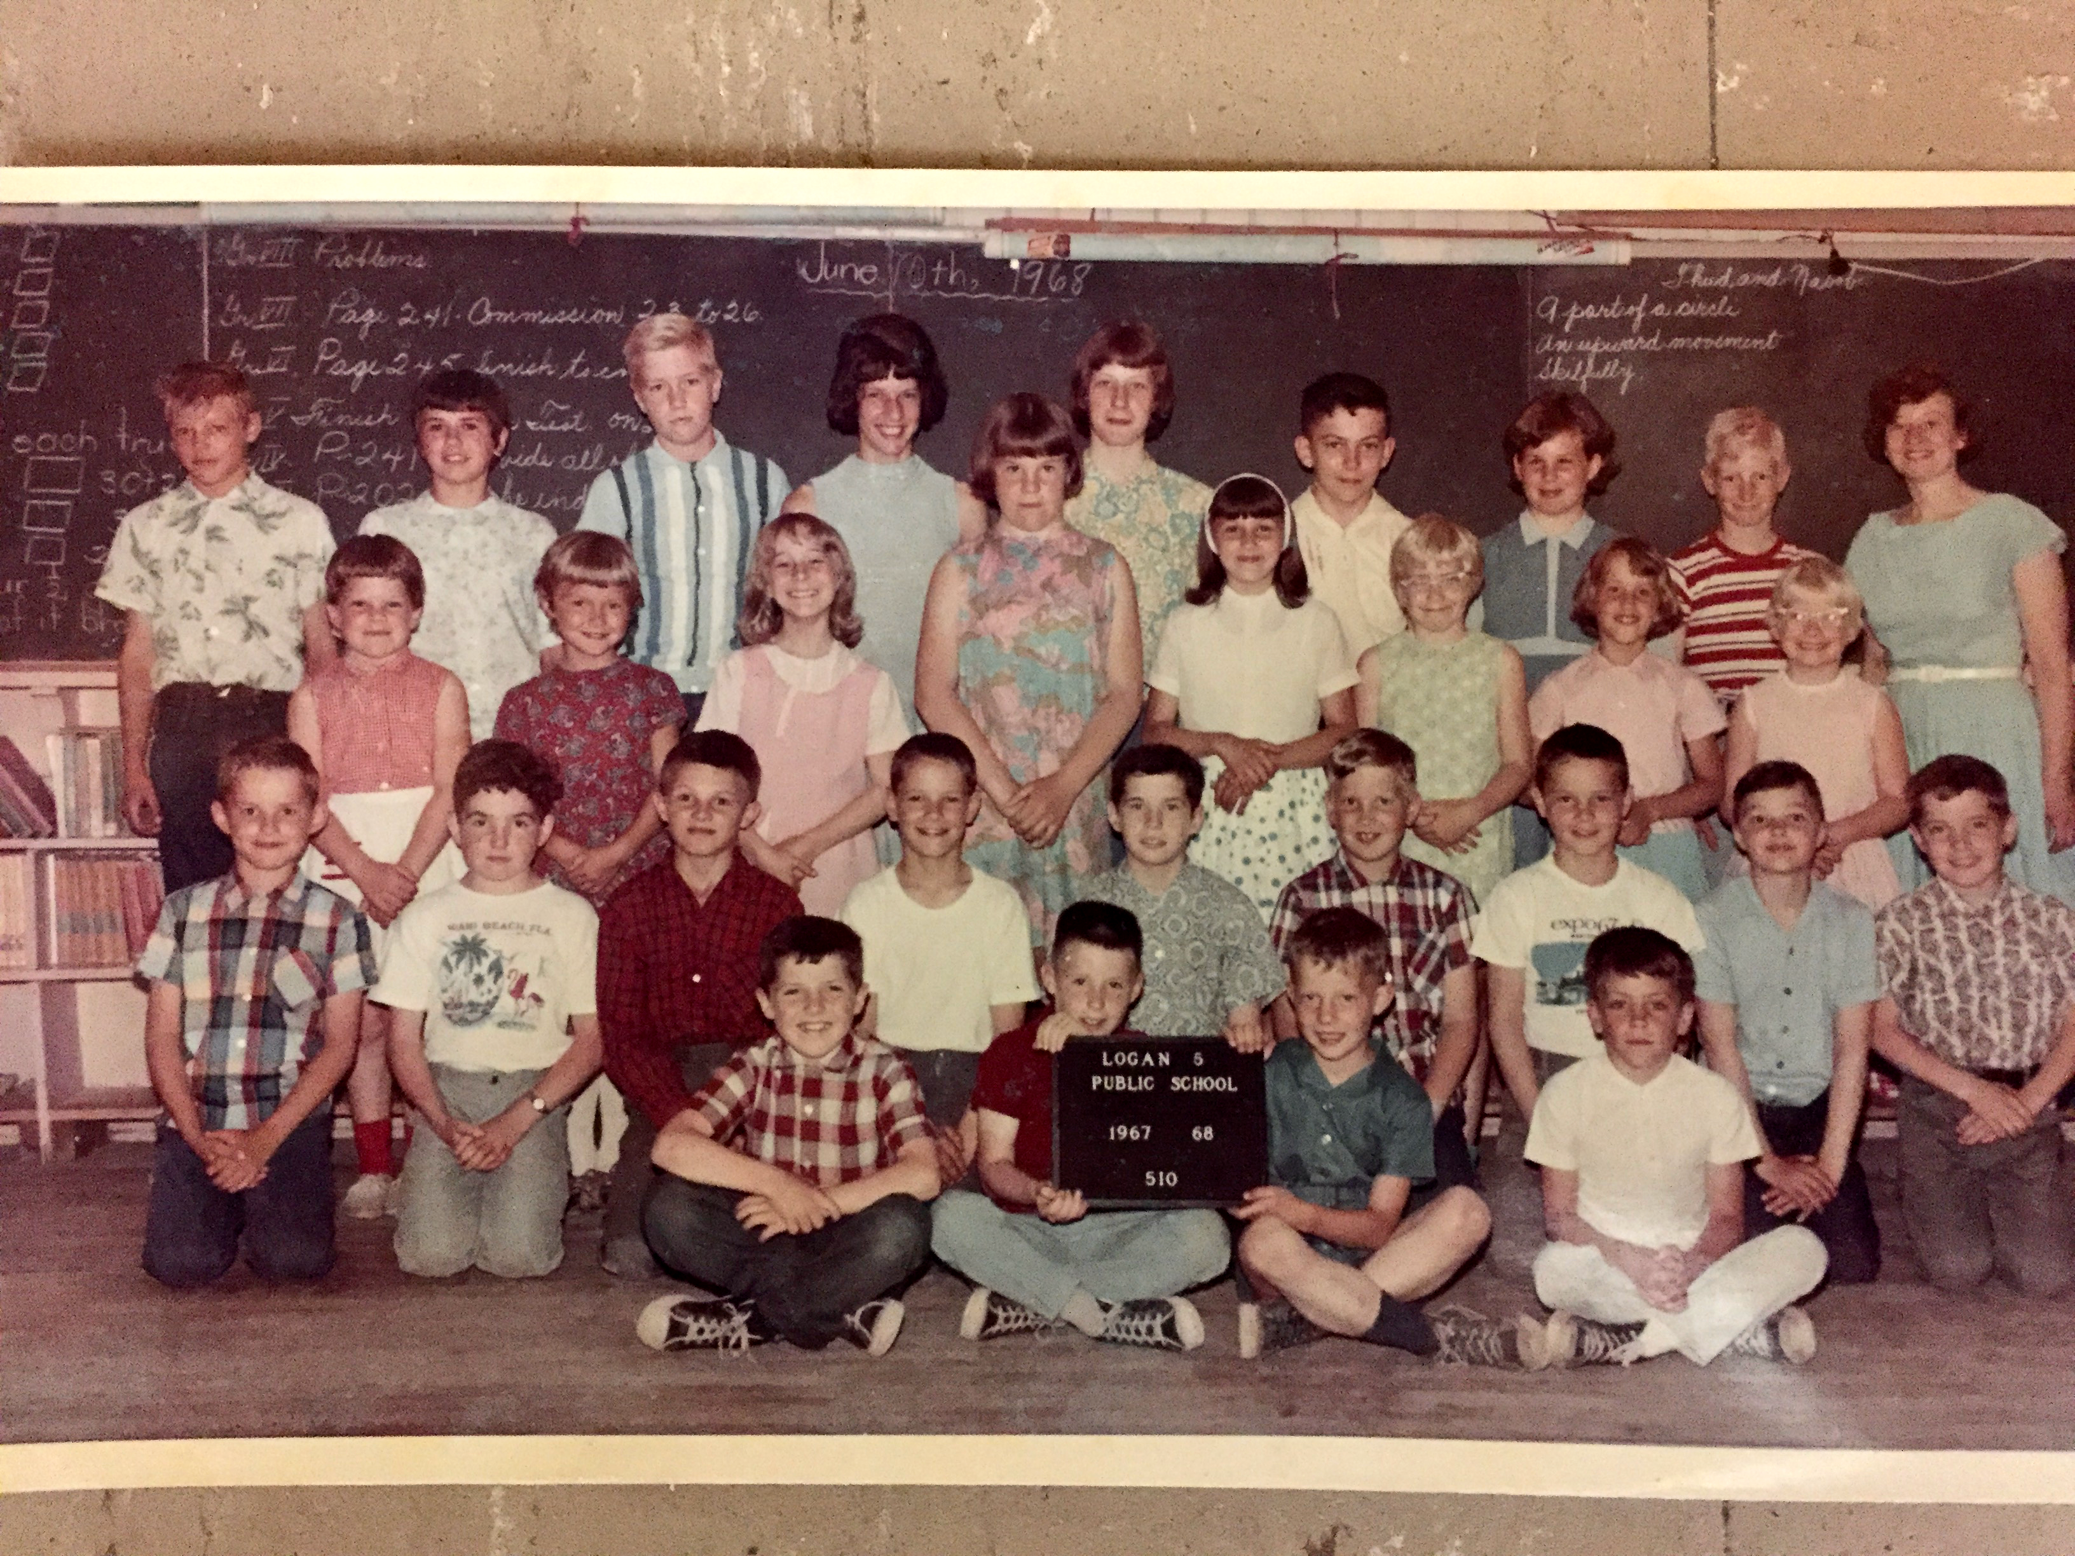
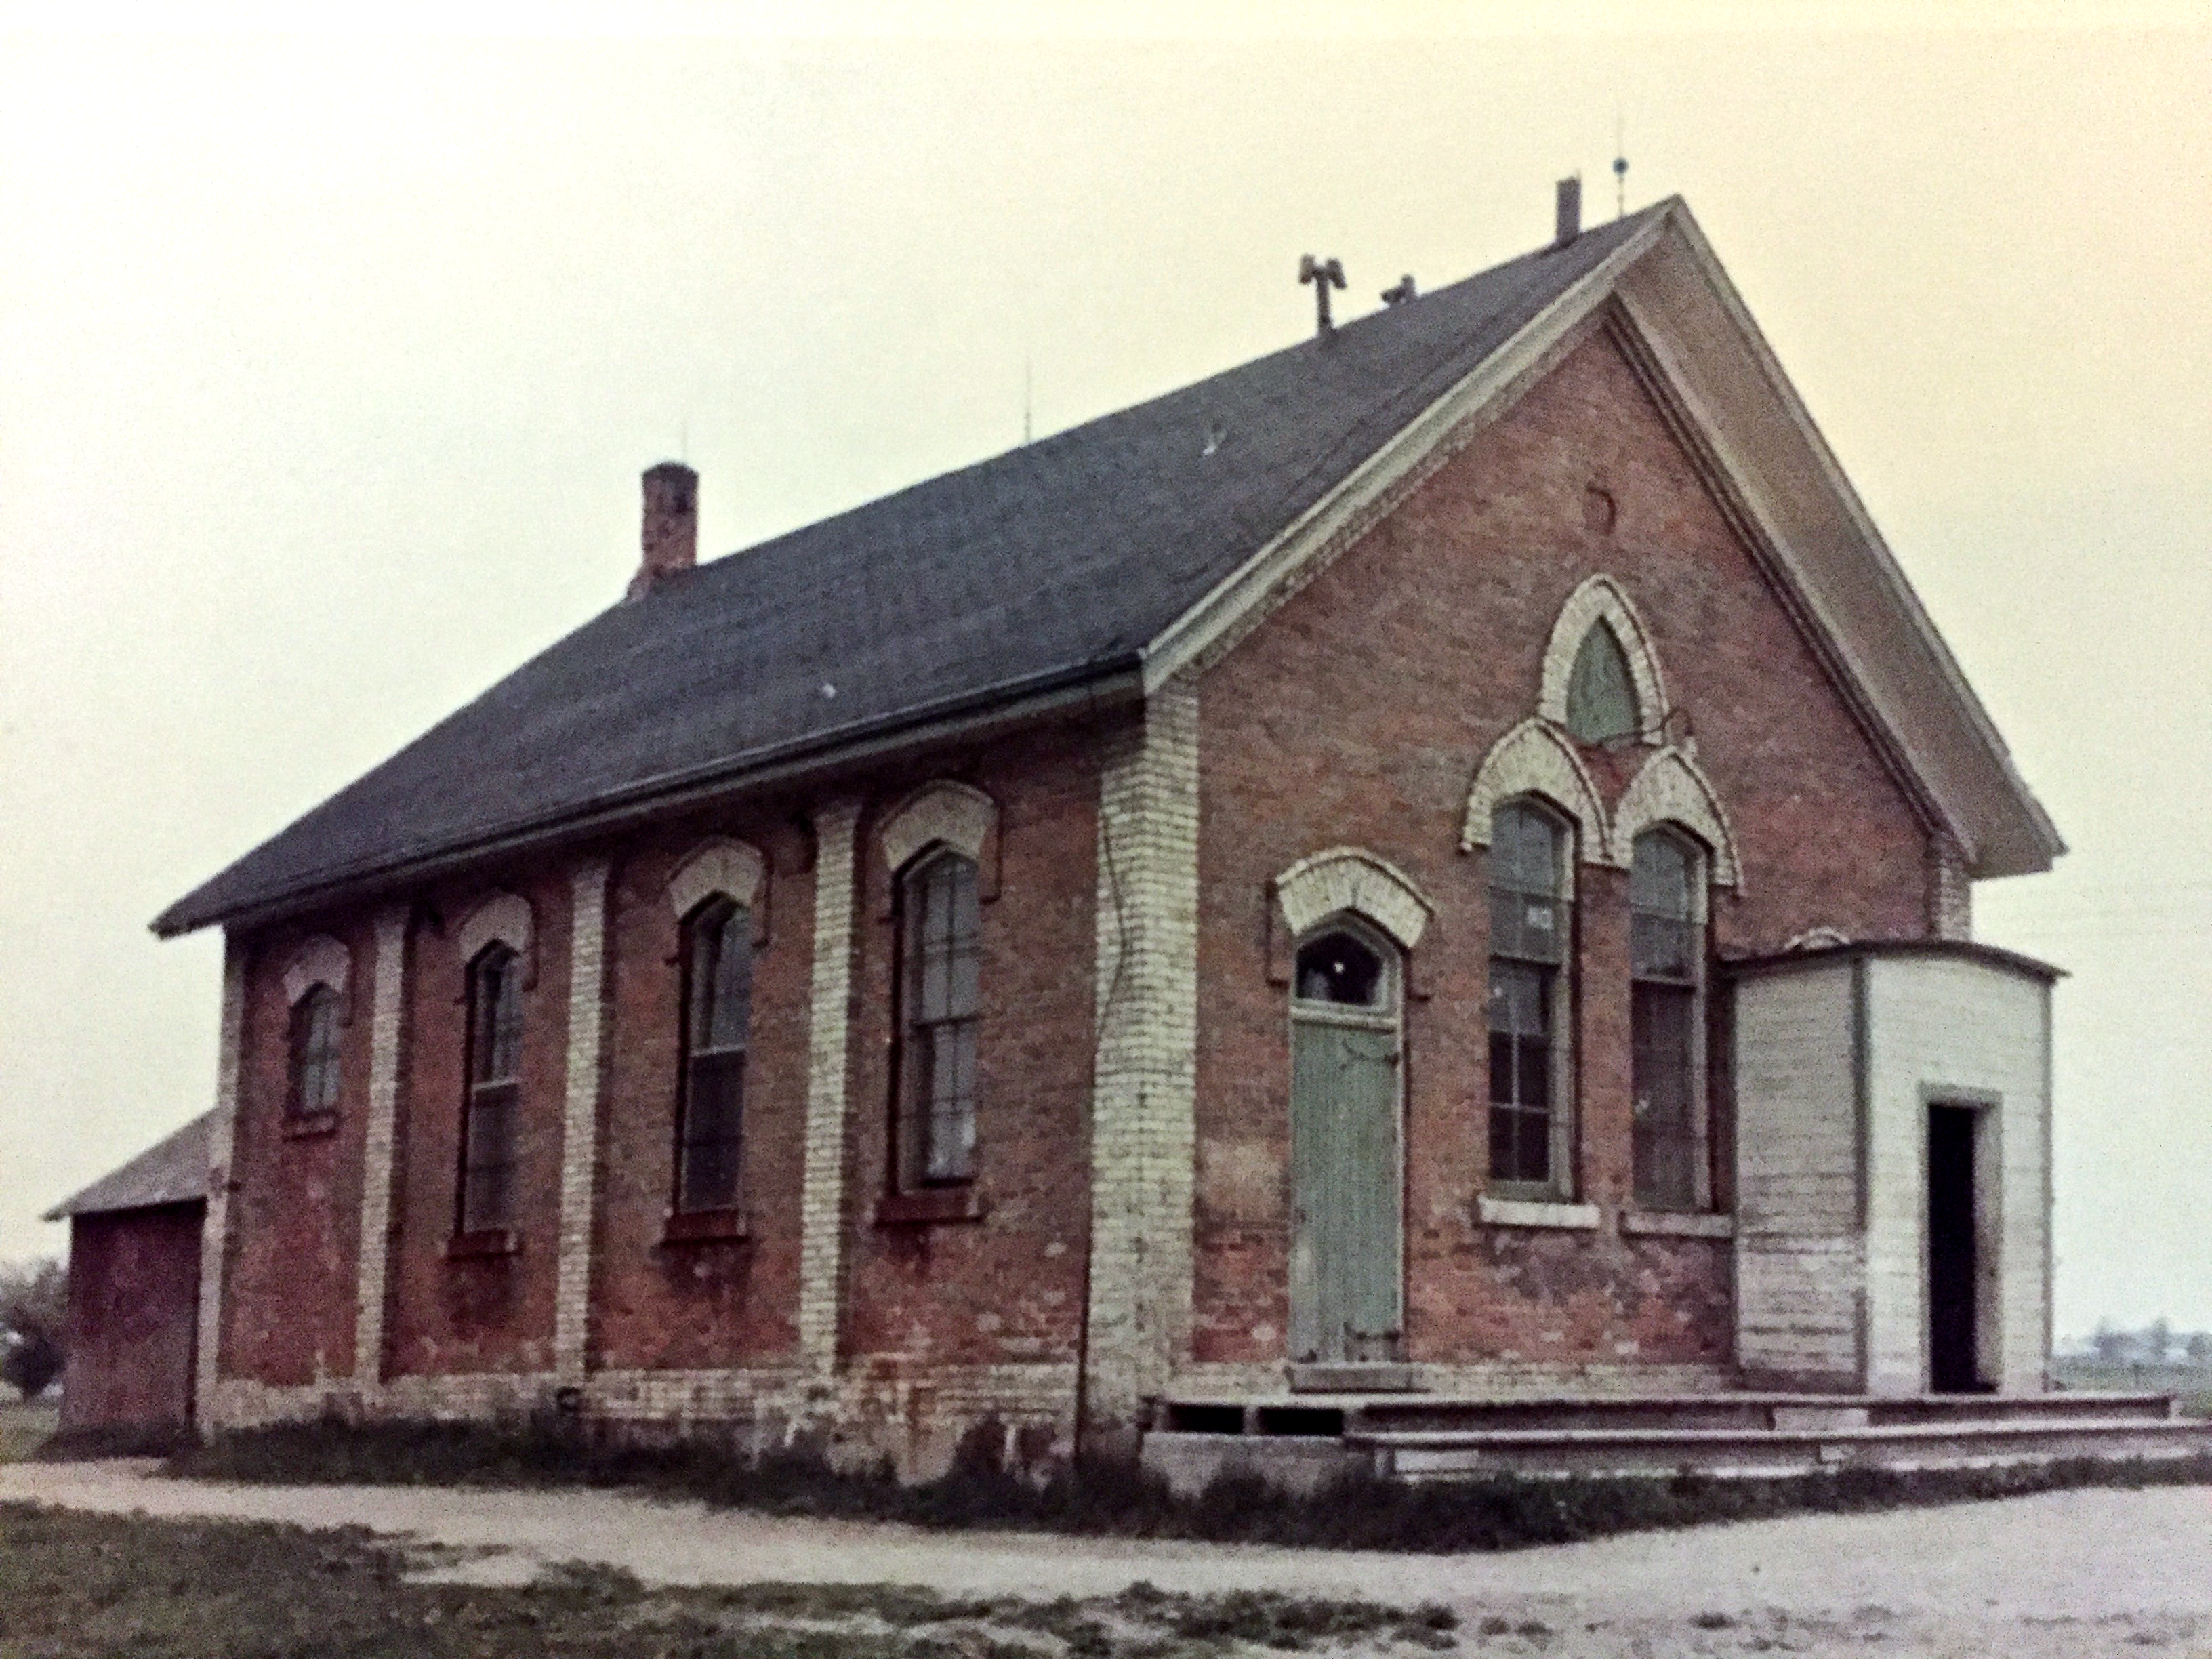
My educational roots

Slide 4
Been institutionalized ever since

Slide 5
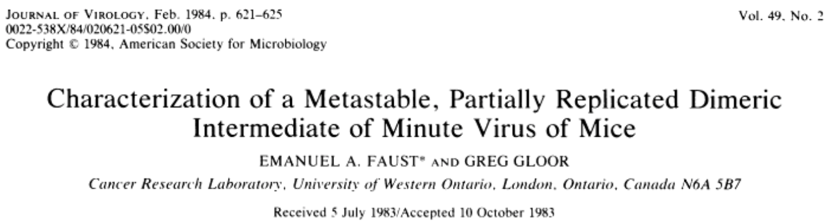
Been institutionalized ever since
20

Slide 6
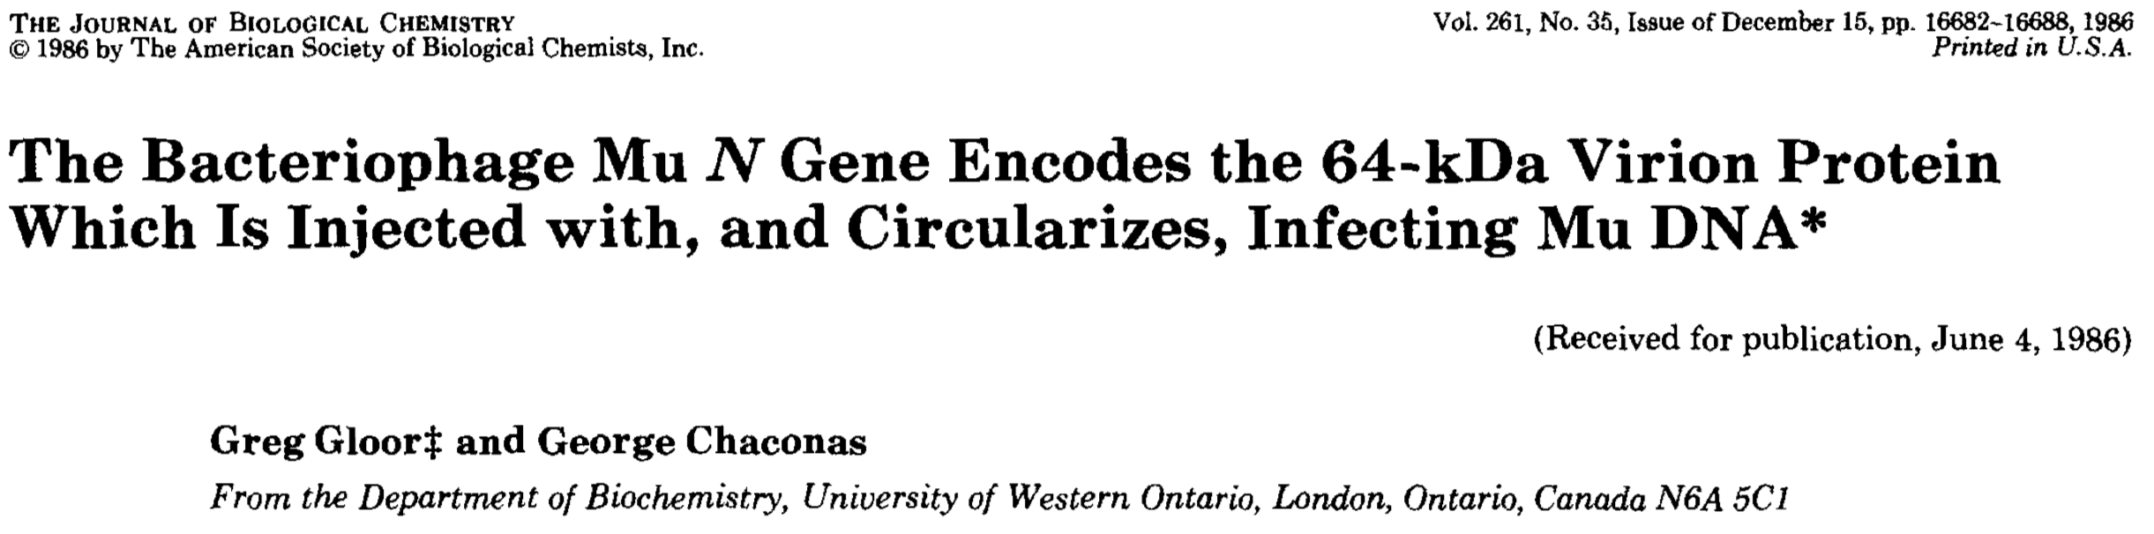
Been institutionalized ever since
32

Slide 7
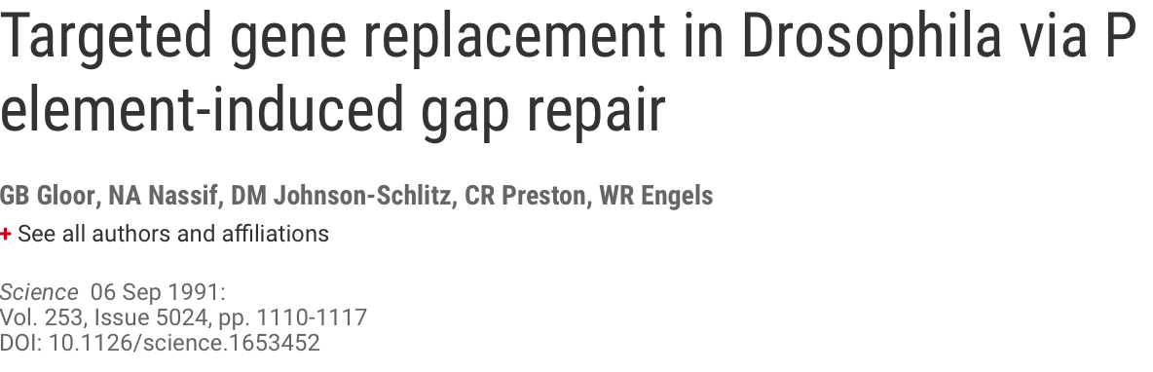
Been institutionalized ever since
386

Slide 8
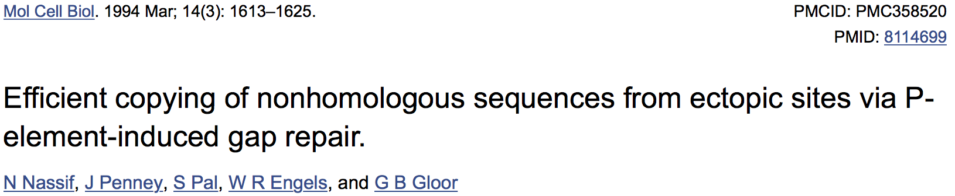
Been institutionalized ever since
501

Slide 9
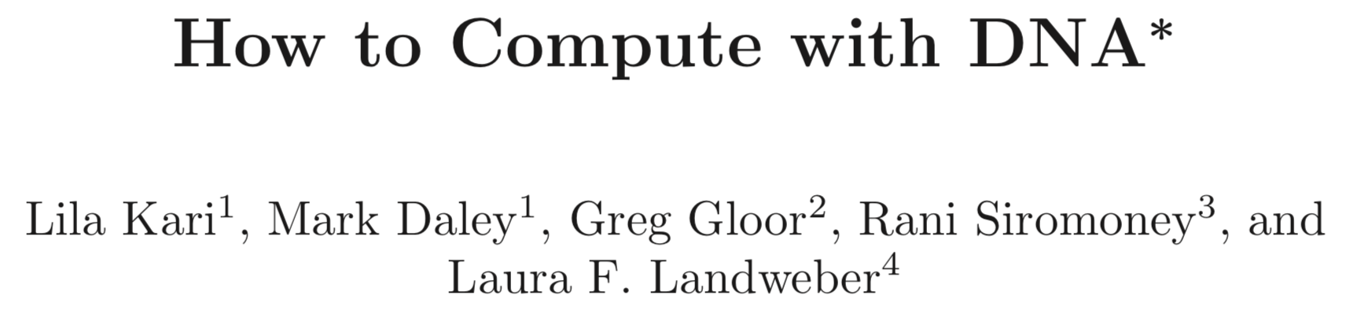
Been institutionalized ever since
4

Slide 10
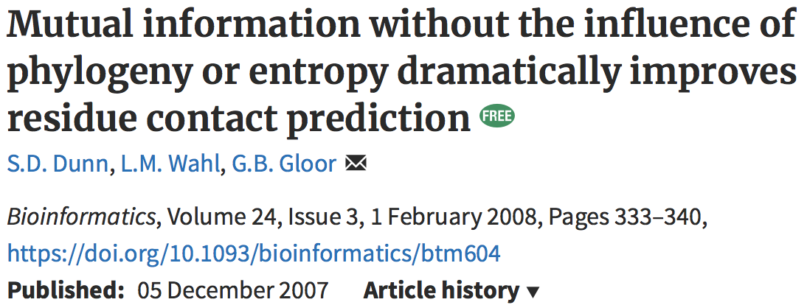
Been institutionalized ever since
312

Slide 11
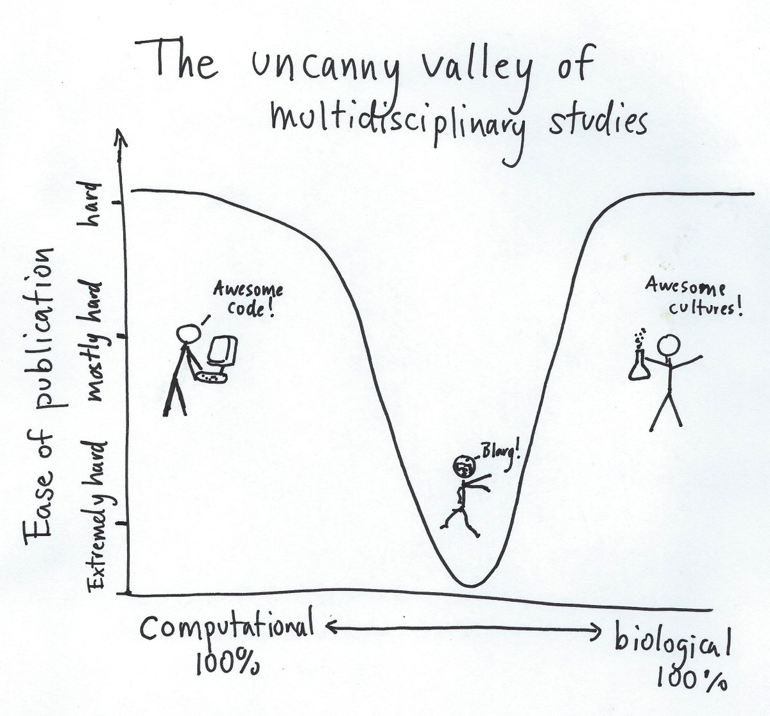
Been institutionalized ever since
312

Slide 12
Been institutionalized ever since
312

Slide 13
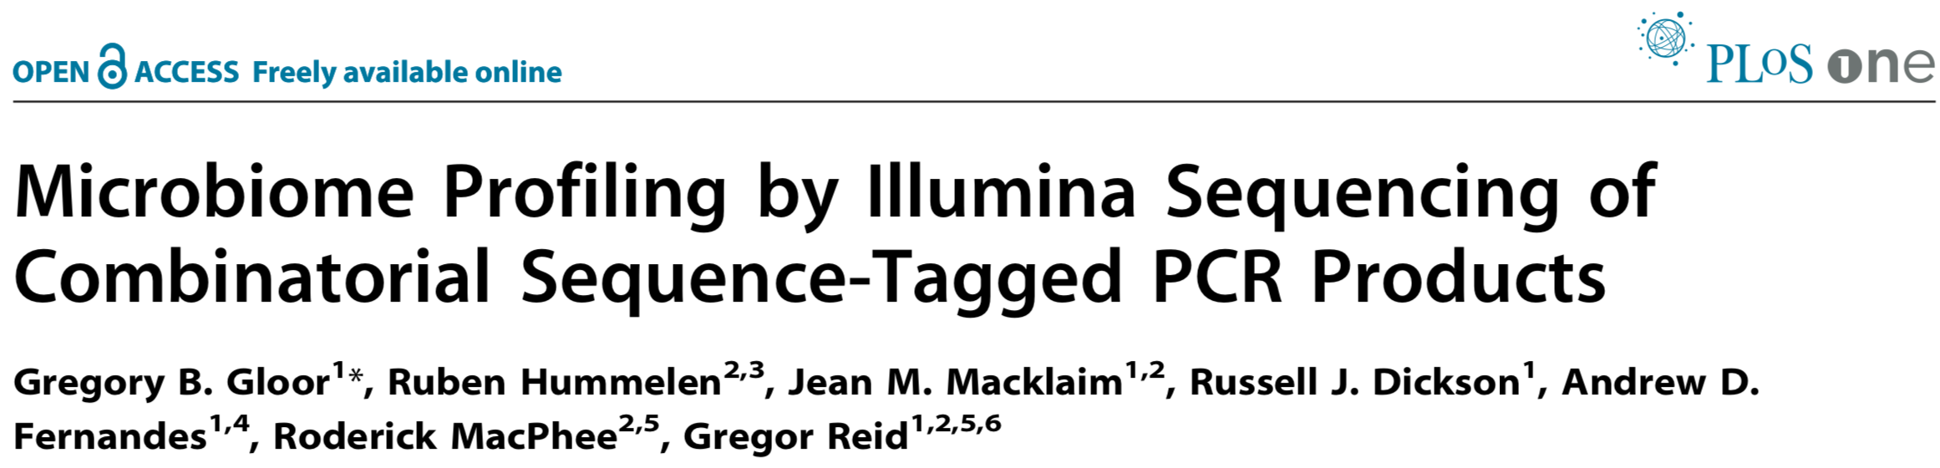
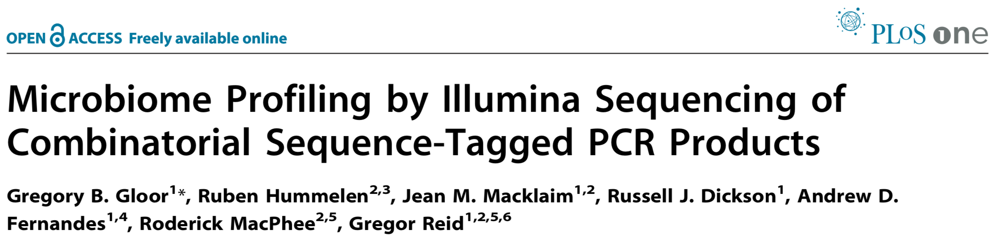
Been institutionalized ever since
218

Slide 14
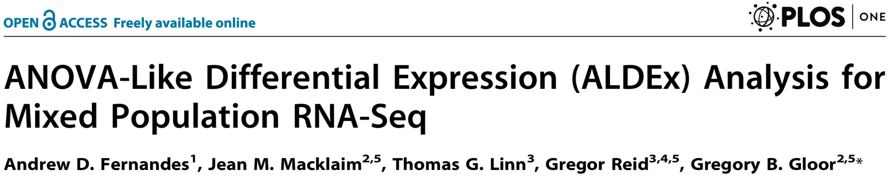
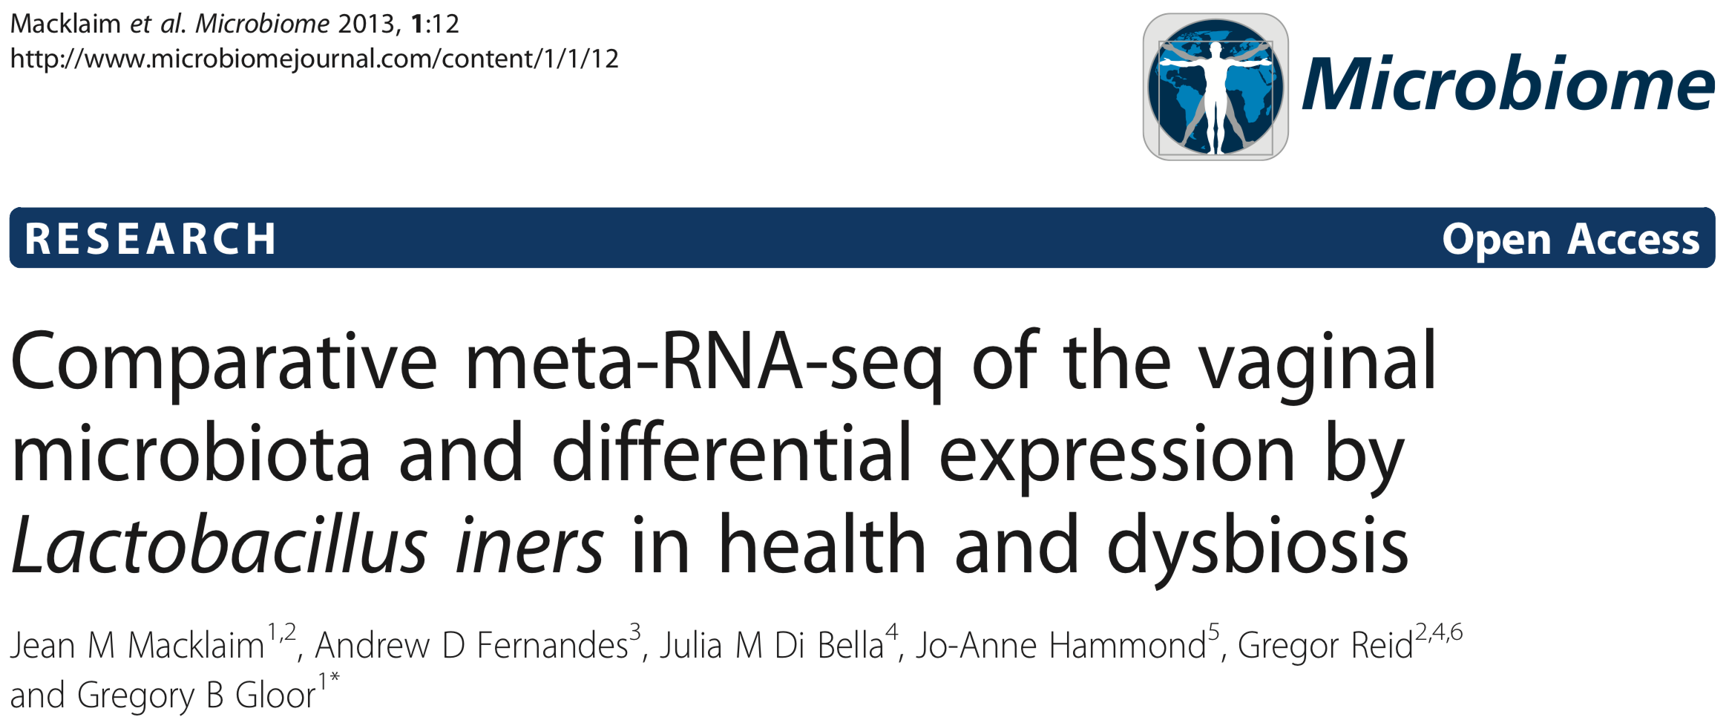
Been institutionalized ever since
80
132

Slide 15
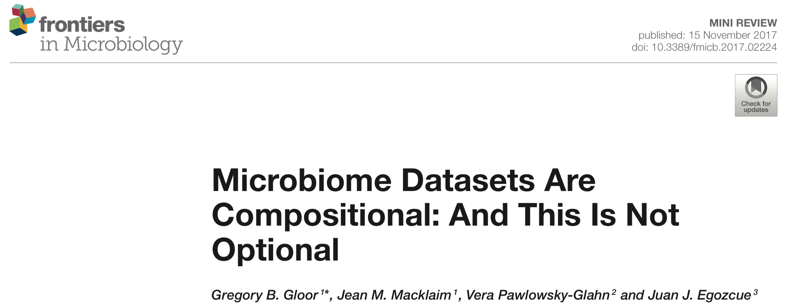
Been institutionalized ever since
34

Slide 16
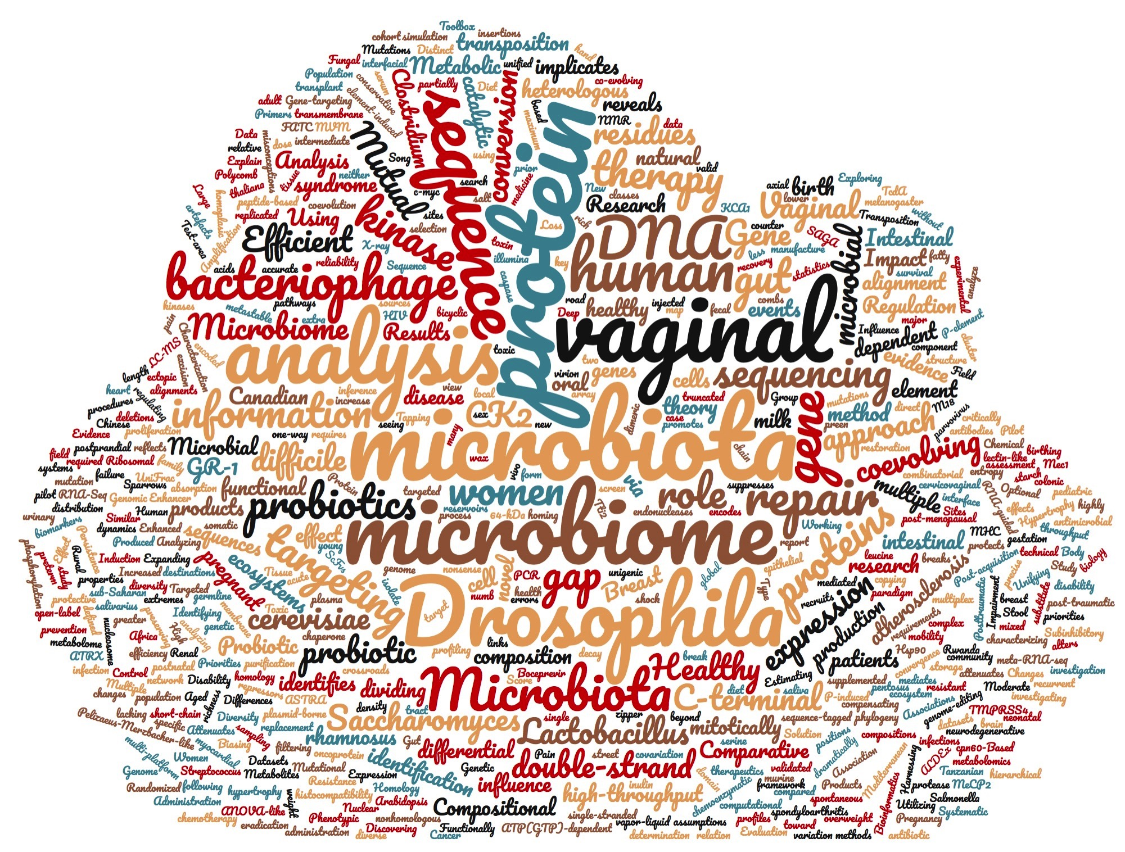
What I’ve worked on

Slide 17
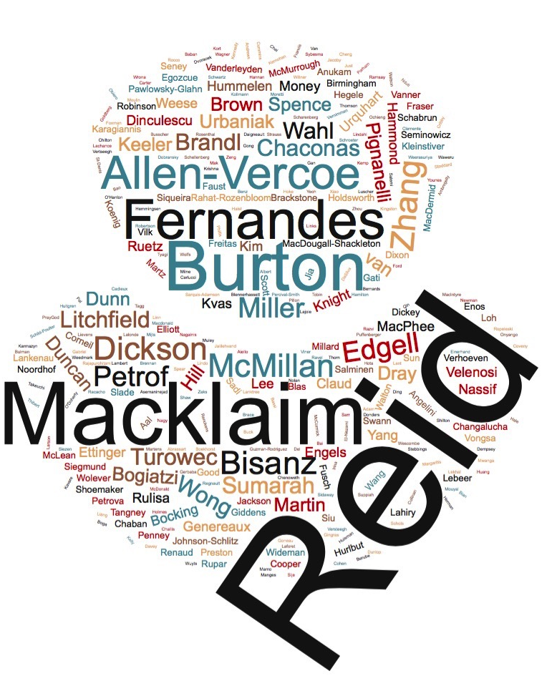
Who I’ve worked with

Slide 18
Summary of service and accomplishments
Awards:
Faculty Scholar 2011-13
4 teaching awards (USC, Schulich, Magee)
MRC Scholar
NCIC K.M. Hunter Fellowship
Teaching
Taught in 1st year meds, honors Biochem, grad Biochem, Comp Sci, Business
External
28 invited outside lectures (Cambridge, Harvard, Tromso, Nairobi, Zhenjiang)
Active collaborations (Egozcue/Glahn, Quinn, Edgell, Reid, Burton, Allen-Vercoe, Finn, Spence)
7 conference workshops (5 organized)
Media: BBC radio, CBC (Radio and TV), CTV, AM radio, Reddit AMA, London Press Club, various print
Papers and Grants
121 peer reviewed papers (44 SA,FA)
Grants from MRC (Operating), NSERC (Discovery, Engage), CIHR (Project,Team,Network), Weston, OCE, AAFC, SEAMO, OGI, CRS, NIH, Industry
Service
Reviewed for CIHR, MRC, Crohn’s & Colitis, OGI, CRC, IODE, NCIC, Jesse’s Journey, PIR, Section Editor Microbiome
Grad Chair, SCITS, SUWWW, SUPR-G, P&T, Selection/Chair search, Mol. Bio program, UMEC appeals, ISSTF-accreditation
Personal
Baseball/Hockey coach 15 years. Level 2 baseball coach, Level 3 (Provincial) Umpire, CSIA Level 1, PADI OW
Proud husband, father, grandfather

Slide 19
My projects in one slide
Our assumptions do not fit the data
Are the data we get from our instruments wrong–or are the assumptions wrong?

Slide 20

The landscape

Slide 21
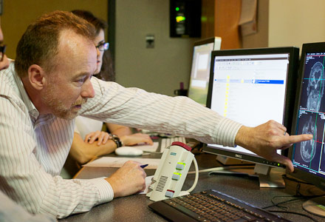
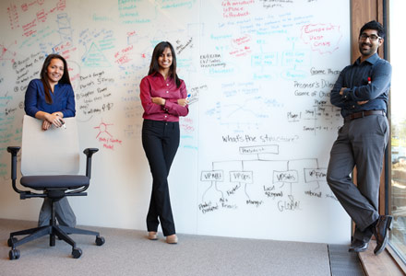
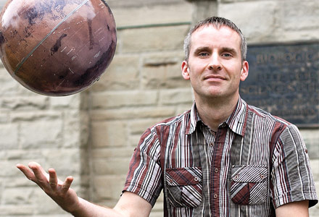
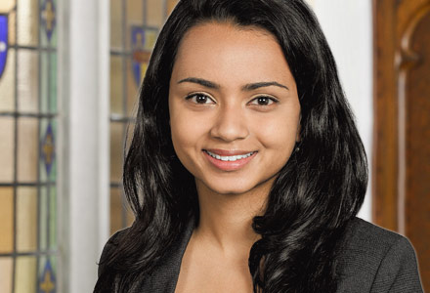
Landscape: Priorities
Create a world-class research and scholarship culture
Provide Canada's best education for tomorrow's global leaders
Engage alumni, community, institutional and international partners
Generate and invest new resources in support of excellence

Slide 22
Local Landscape
The Schulich School of Medicine & Dentistry will be a global leader in optimizing life-long health through innovations in research, education and active engagement with our communities.
The Schulich School of Medicine & Dentistry provides outstanding education within a research-intensive, distributed learning environment where tomorrow’s physicians, dentists, health researchers and other scholars learn to be socially responsible leaders in the advancement of human health locally, regionally and globally.

Slide 23
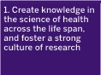


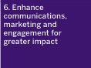
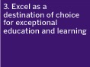
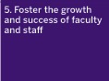

Shulich Optimizing Life-Long Health 2011-2021

Slide 24
Biochemistry Department Mission
To advance the understanding of the molecular basis of health and disease through excellence in research and education¹
Advance scientific discoveries through our successful research programs
Participate in the scientific education of undergraduate students
Provide high-quality research training for graduate students and post-doctoral researchers²
1-Biochemistry self study: 2-Biochemistry web site

Slide 25
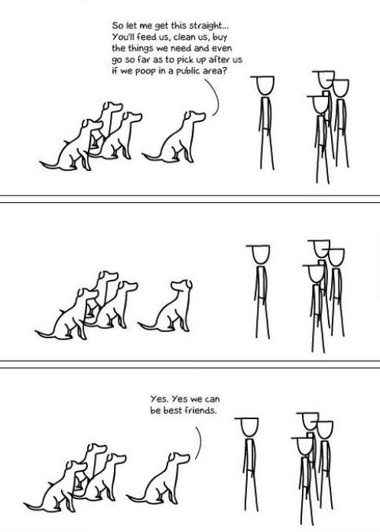
Align our priorities with those of our Institution
Everything is a bargain
If we want something we have to be willing to give something in return
What do we want?
What do we have to give?

Slide 26
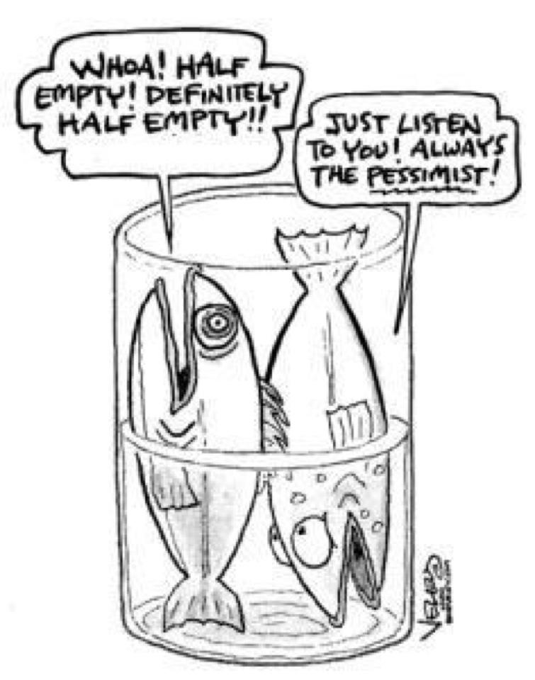
How well do we align?

Slide 27
How well do we align?
Create knowledge in the science of health across the life span and foster a strong culture of research
Strengthen research knowledge translation and implementation to achieve health benefits for individuals and populations
Excel as a destination of choice for exceptional education and learning
Strengthen and develop sustainable regional and international partnerships and networks
Foster the growth and success of faculty and staff
Enhance communications, marketing and engagement for greater impact
Be fiscally responsible, supporting the vision and mission of the School

Slide 28
My views
Create knowledge in the science of health across the life span and foster a strong culture of research
Strengthen research knowledge translation and implementation to achieve health benefits for individuals and populations
Excel as a destination of choice for exceptional education and learning
Strengthen and develop sustainable regional and international partnerships and networks
Foster the growth and success of faculty and staff
Enhance communications, marketing and engagement for greater impact
Be fiscally responsible, supporting the vision and mission of the School

Slide 29
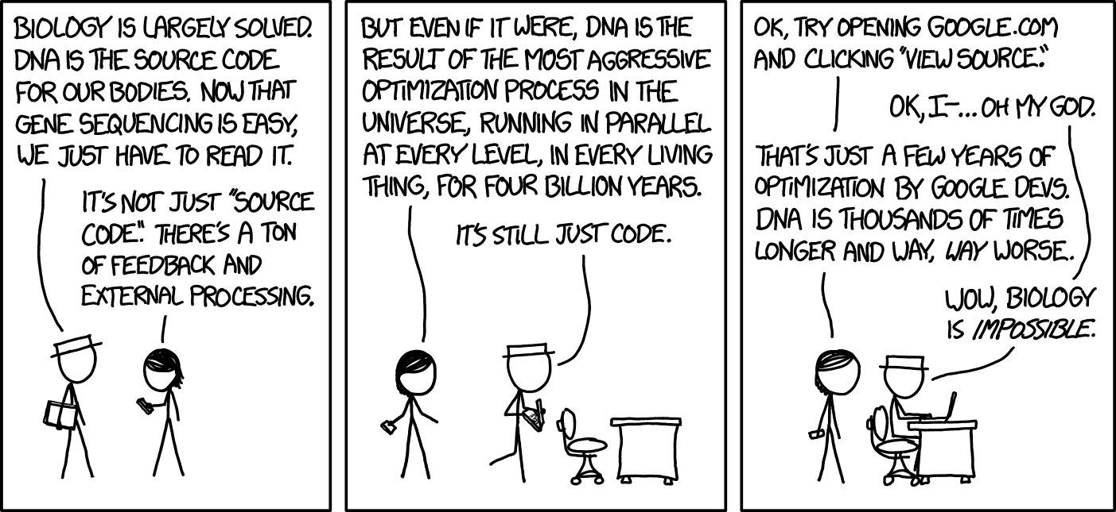
Biomedical Science in not Rocket Science
XKCD.com

Slide 30
What about the funding landscape?

Slide 31
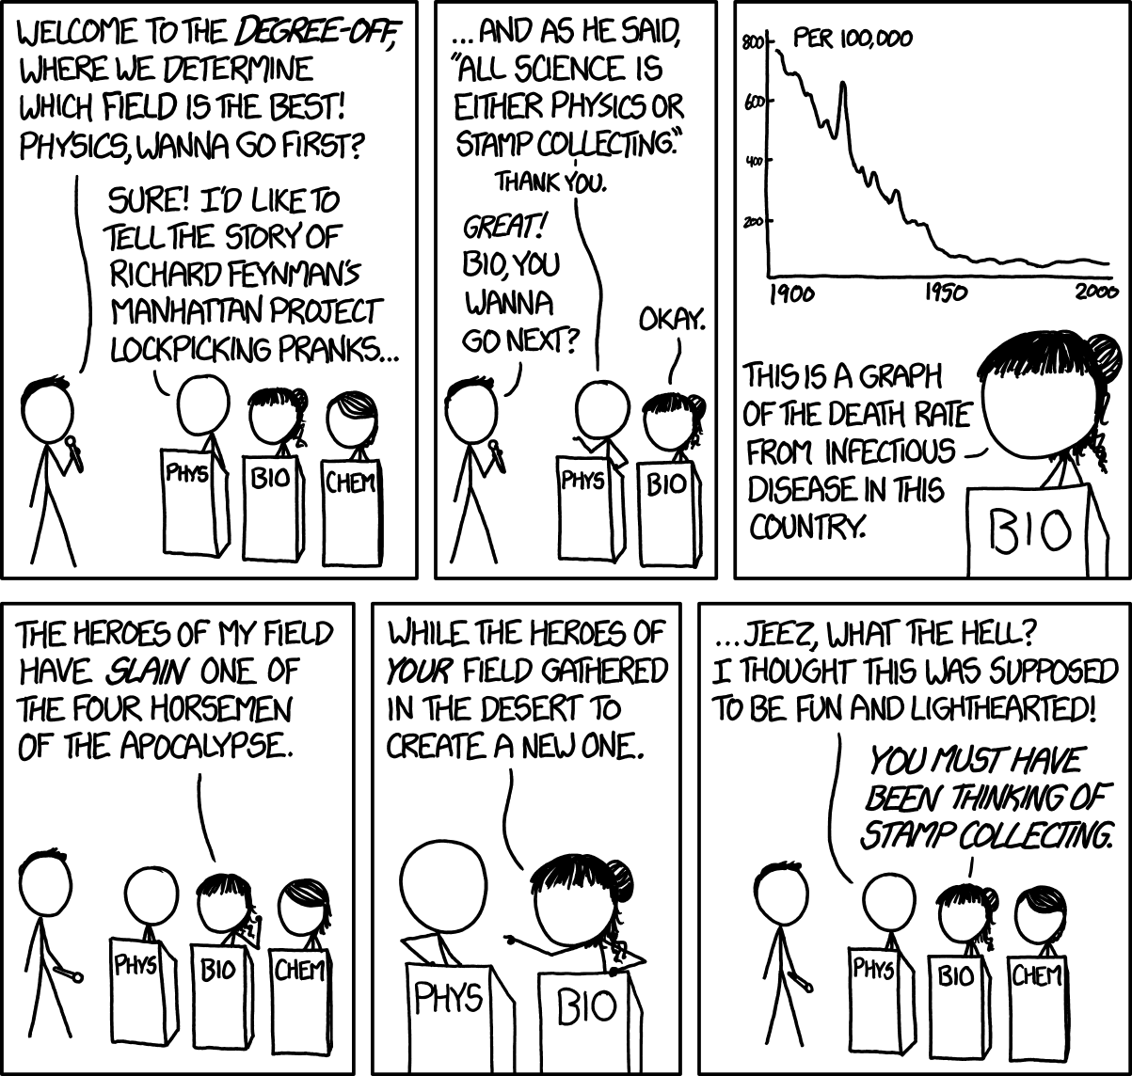
Purity is not that important–results are
XKCD.com

Slide 32
Departmental research connectivity (PubMed)
At least 1
> 1
. . . . . .
. . . . . .
. . . .
> 2
. . . . . .
. . . . . .
. .
Notes:
25 total faculty
1 19/25
>1 1525
>2 11/25

Slide 33
Departmental research connectivity (PubMed)
At least 1
> 1
. . . . . .
. . . . . .
. . . .
> 2
. . . . . .
. . . . . .
. .
Notes:
25 total faculty
1 19/25
>1 1525
>2 11/25

Slide 34
But who doesn't do Biochemistry?
Anatomy and Cell Biology
Aberrant Cx43 expression and mislocalization …
Protein structure and import …
Physiology and Pharmacology
Functional Characterization of Novel Atrial Fibrillation-Linked GJA5 (Cx40) Mutants …
A switch in G protein coupling …
Pathology and Lab Medicine
Diagnosing multiple genetic diseases in families by whole exome sequencing
Improving the translation of novel biomarkers to clinical practice: The story of cystatin C implementation in Canada
Microbiology and Immunology
A Highly Conserved Residue in HIV-1 Nef Alpha Helix 2 Modulates Protein Expression.
Involvement of reductases IruO and NtrA in iron acquisition …

Slide 35
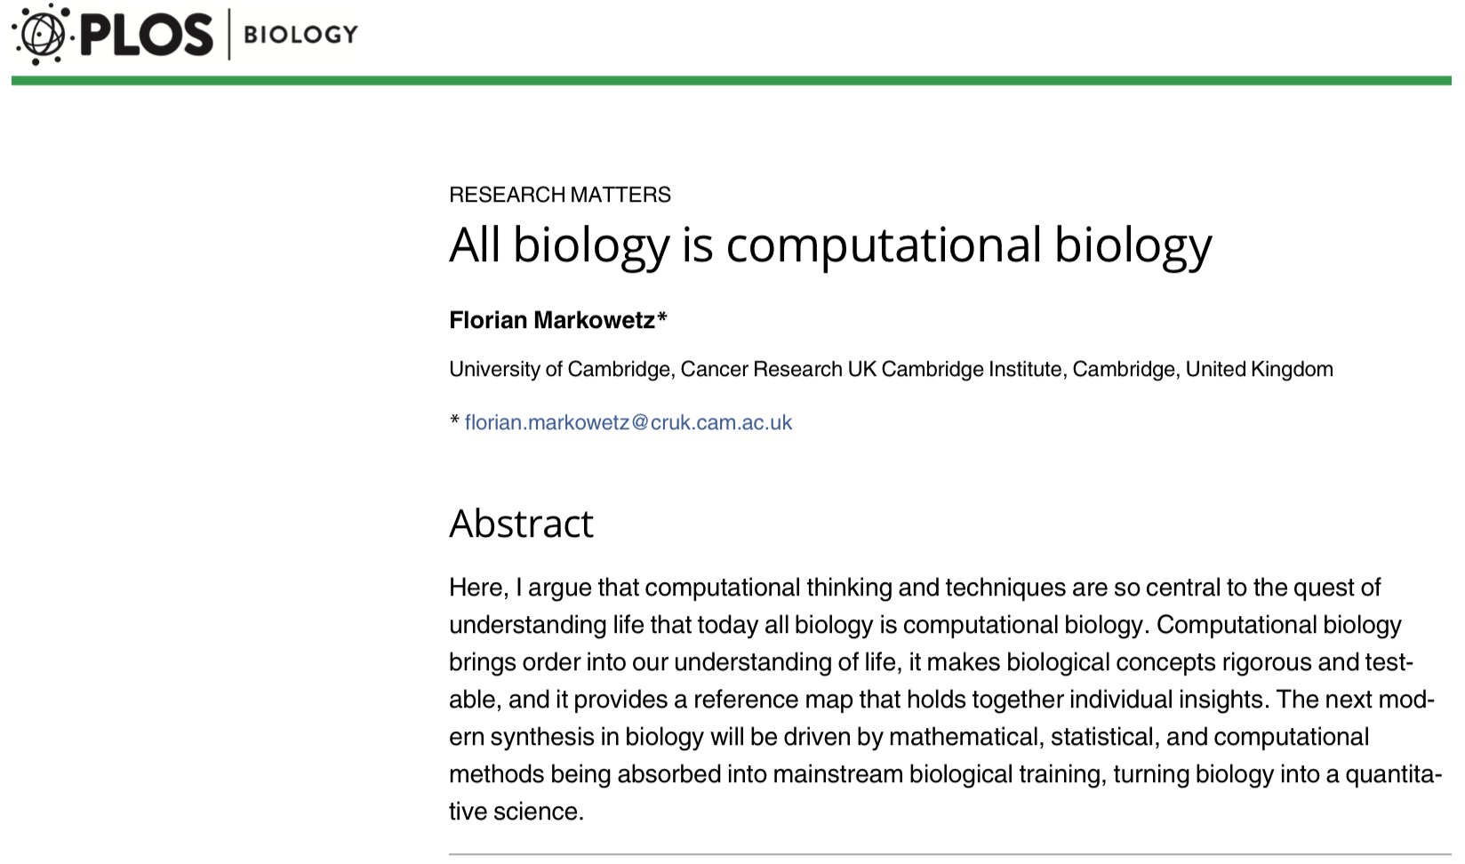
Biomedical science is …

Slide 36
Biochemistry has always evolved
What is that molecule?
This is my molecule
My molecule is the COU
My molecule changes your molecule
Our molecules work together
We can predict emergent properties from our molecules
We can model a cell or even ecosystem using available biochemical data
We can build new cells and tissues with properties we want

Slide 37
Biochemistry in 20 years
Structure and Function will be important
Likely high throughput
Likely re-analysis
Synthetic Biology will be a major force
Molecular Biology is the tool
Synthetic Biology is the application
Predicting and understanding will be key
Systems biology will fill the gap
What is likely to happen given the inputs
What did happen given the experiment
What generalities can be gleaned

Slide 38
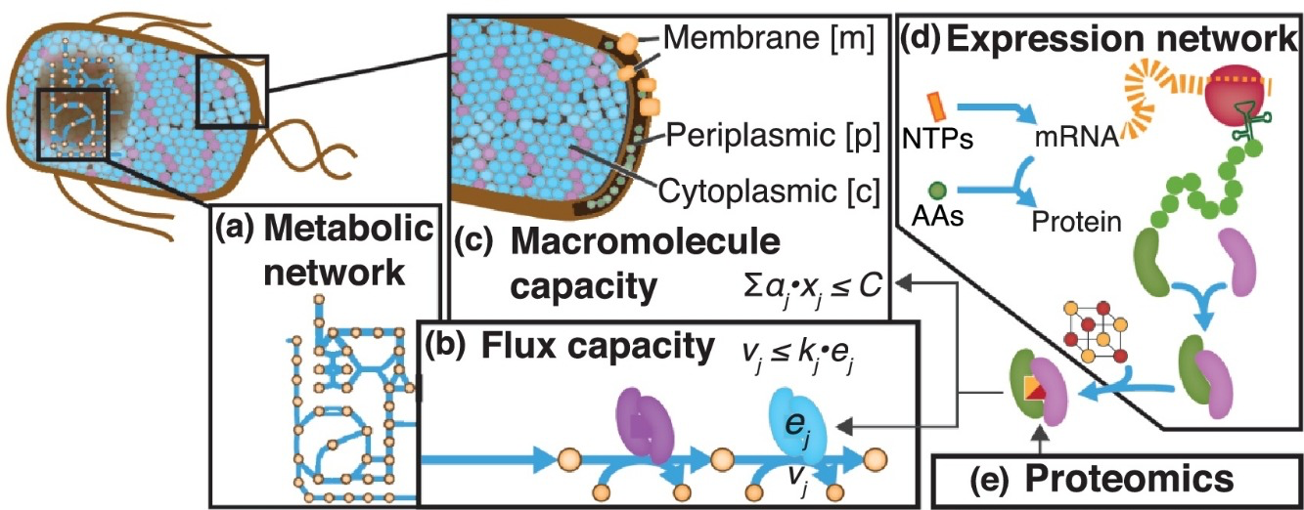
When I see Systems Biology I see Biochemistry writ large …
Genetics
Molecular
Biology
Cell Biology
Biochemistry
Enzyme Kinetics
Proteomics
Transcriptomics
Metabolomics
Biochemistry
Molecular Biology
Modeling the multi-scale mechanisms of macromolecular resource allocation Cur. Op. Micro. 2018
Notes:
Figure 1. Network models of metabolism and macromolecule expression. (a) a metabolic network is reconstructed from the microbe's annotated genome. (b) Metabolic flux (vj) is constrained by catalytic efficiency (kj) and enzyme abundance (ej). This general form can be reformulated [34]. (c) Macromolecule (xi) capacity is constrained based on its physical properties (aj) such as molecular weight and a total cell capacity (C). Macromolecule abundance can be computed using a macromolecule expression network (d), which can vary in level of detail, or from proteomics data (e). To constrain total mRNA, RNA-Seq is used instead.

Slide 39
What looks different

Slide 40
Are manifestations of the same thing

Slide 41
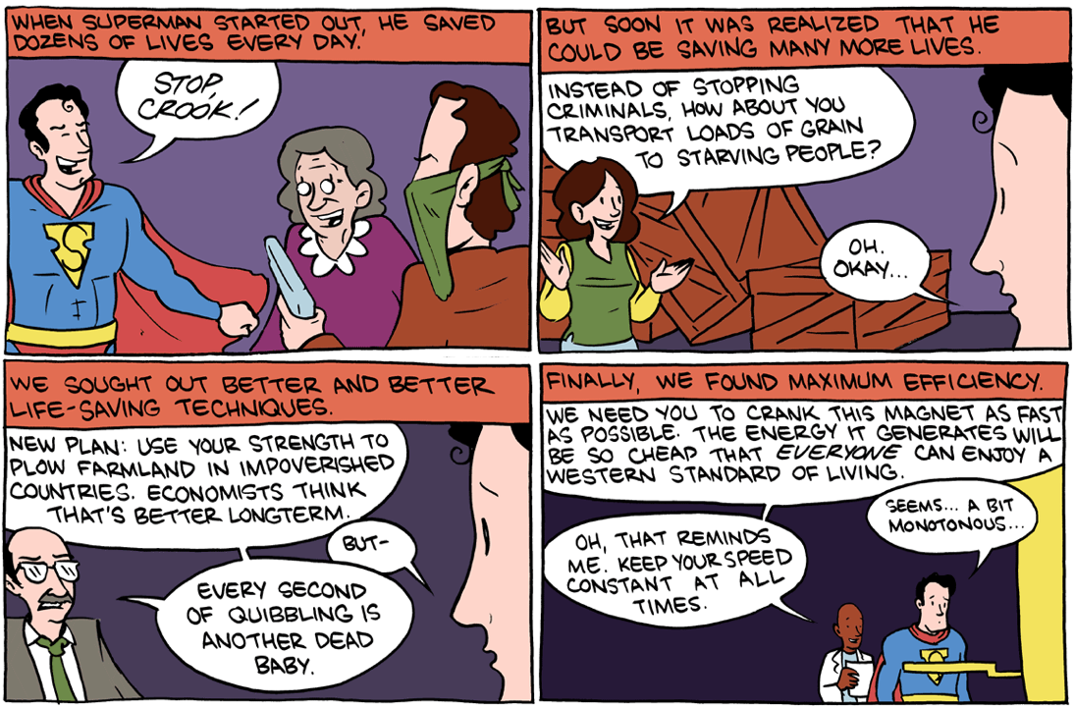
What makes a real super contribution?
SMBC-comics.com / 80000hours.org

Slide 42
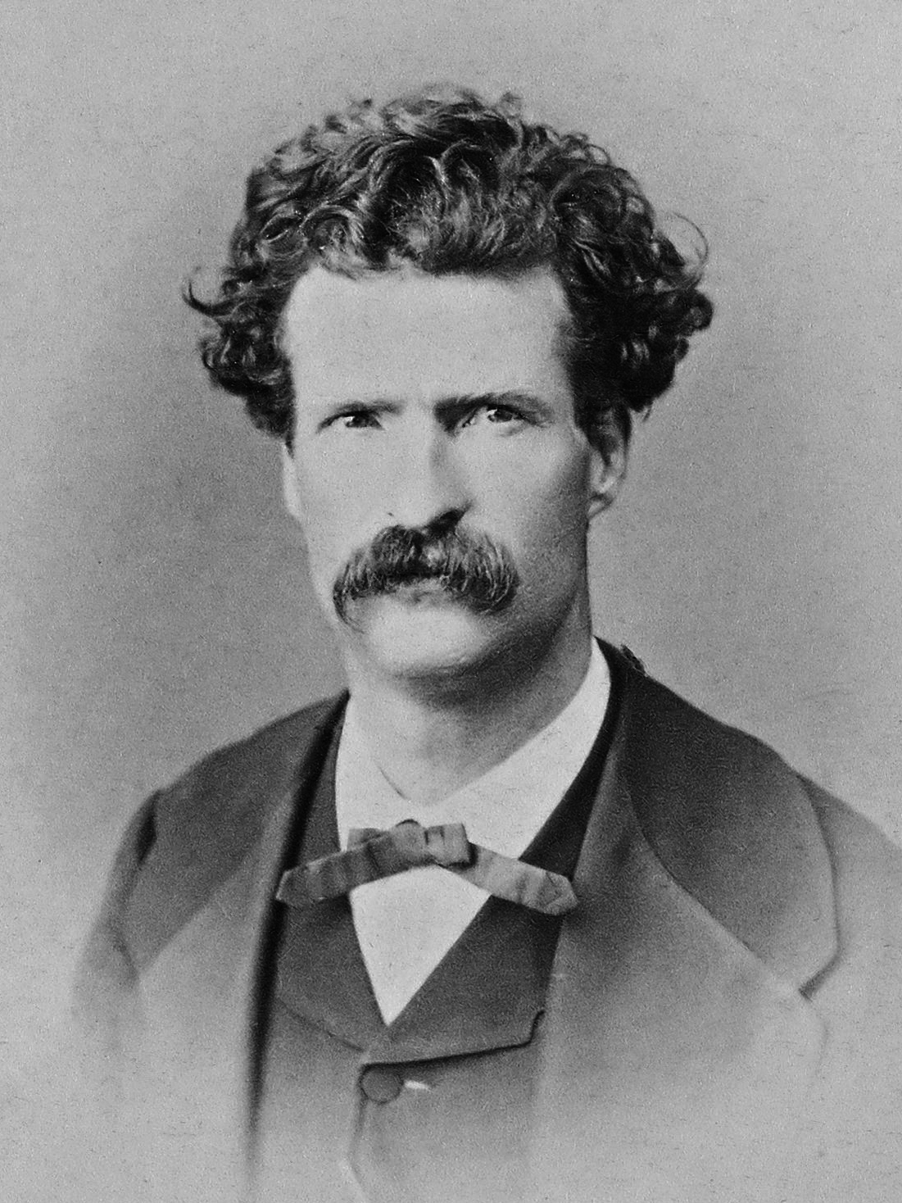
To sum up
To be great, truly great, you have to be the kind of person who makes the others around you great.

Slide 43
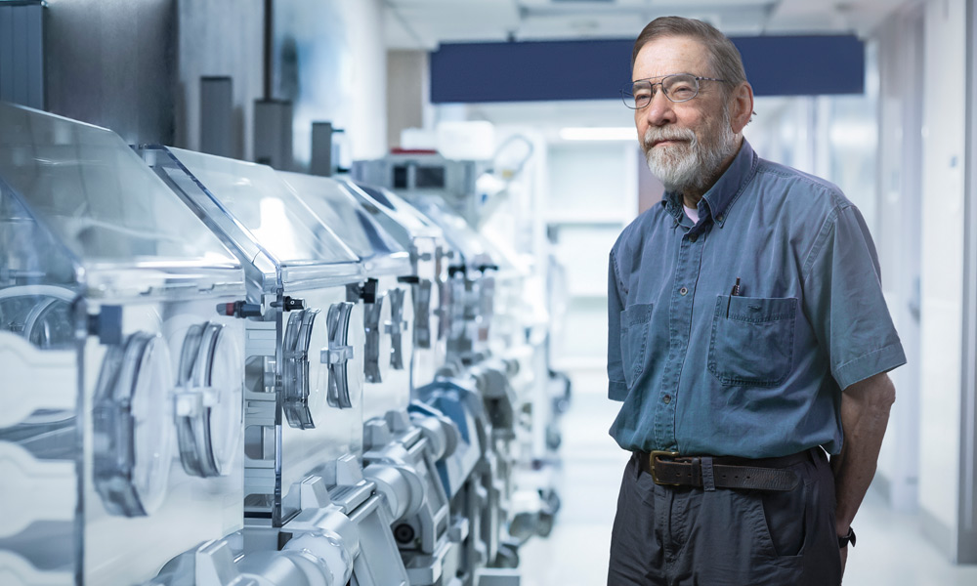
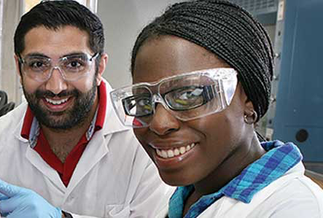
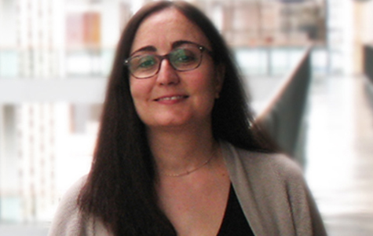
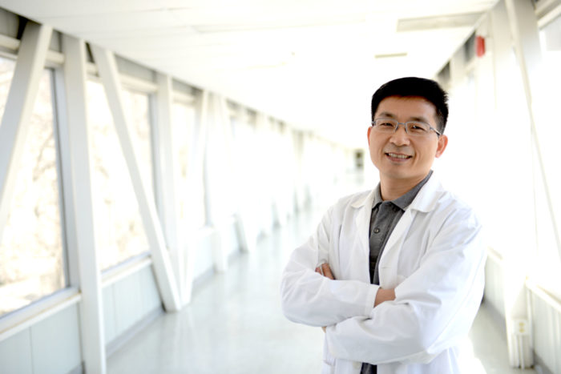
UWO vision amended
Create a world-class research and scholarship culture
Provide Canada's best education for tomorrow's global leaders
Engage alumni, community, institutional and international partners
Generate and invest new resources in support of excellence

Slide 44
Vision – Selection committee

Slide 45
Align Biochemistry with Schulich and Western
Create knowledge in the science of health across the life span and foster a strong culture of research
Strengthen research knowledge translation and implementation to achieve health benefits for individuals and populations
Excel as a destination of choice for exceptional education and learning
Strengthen and develop sustainable regional and international partnerships and networks
Foster the growth and success of faculty and staff
Enhance communications, marketing and engagement for greater impact
Be fiscally responsible, supporting the vision and mission of the School
This happens if we do
the rest right
Recognize collaboration
Become known –
science is social
Environment of mentorship
Every paper is a press release, tweet or blog

Slide 46
Focus on collaboration outside traditional sources

Slide 47
We must plan 20 years ahead
Biochemistry will always be important
It is the foundation from which order emerges
Computers are not going away
We need to reverse our disadvantage
High throughput biology is not going away
Robotics, microfluidics
Instrumentation as a commodity
Trends accelerate, they don’t dissipate
There will be disruption
We cannot compete without commitment

Slide 48
We must plan 20 years ahead
Structure and Function will be important
New platforms
Synthetic Biology will be a major force
This will just get easier
Systems biology will fill the gap
Computers will get faster

Slide 49
Draft Teaching Plan
Transform Graduate Education
Enable Leadership in Post-Genomic Research
Enhance computational competence in experimental design & analysis
Tri-Council, Genome Canada, Gates, CFI, WHO, SPOR, Industry
Embed new hire(s) within the departments: change the culture
Support new hire(s) with sufficient startup money to compete globally
Build a community across Schulich and Science Faculties

Slide 50
What makes a real super contribution?
SMBC-comics.com / 80000hours.org

